Slide 1
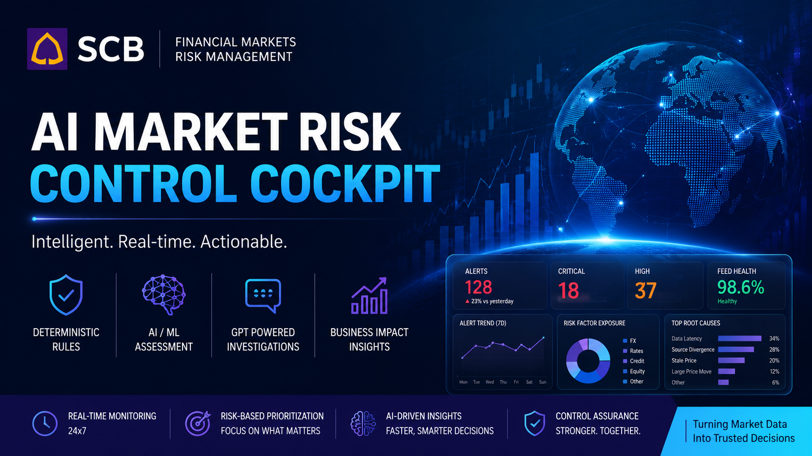
SCB
AI-Powered Value at Risk Market Data Quality
Control Cockpit

Slide 2
THE PROBLEM
Market Risk teams need decisions, not more alerts
Thousands of technical alerts can compete for attention — but only a small subset may warrant immediate action.
MARKET DATA
FEEDS
TECHNICAL
ALERTS
MANUAL
INVESTIGATION
BUSINESS
CONTEXT
PRIORITISATION
Why the current process is hard
• Rule breaches do not automatically mean material business risk
• Analysts must connect data-quality issues with exposure and risk context
• High alert volumes create noise and investigation effort
• Technical evidence is difficult to communicate quickly to senior stakeholders
The opportunity is not simply to detect more anomalies — it is to identify which ones matter.
AI-Powered Market Risk Control Cockpit
1

Slide 3
THE SOLUTION
One control cockpit moves from detection to action
One observation. Multiple analytical lenses. One prioritized control decision.
ENRICHED MARKET DATA
RULE CONTROLS
ML DETECTION
CONTEXT
Known control breaches
Unusual multivariate patterns
Corroborating evidence
BUSINESS IMPACT
EVIDENCE CONFIDENCE
PRIORITY
ACTION
DETECT
ASSESS
ACT
AI-Powered Market Risk Control Cockpit
2

Slide 4
WHY IT IS DIFFERENT
Technical severity is not the same as business priority
A technically extreme anomaly can still be prioritised below Critical once evidence and materiality are considered.
Rule Severity
CRITICAL · 100/100
ML Severity
CRITICAL · 98.5/100
CRITICAL
Evidence Confidence
82.2/100
technical detection
Exposure
$16.3M
≠
Portfolio Risk Contribution
4.47%
CRITICAL
Business Impact
76.3/100
business priority
Final Priority
HIGH
Business Impact combines technical severity, supporting evidence and materiality before Final Priority is assigned.
Required Action
Investigate within 1 hour
AI-Powered Market Risk Control Cockpit
3

Slide 5
PROTOTYPE OUTCOME
The prototype concentrates attention on a small actionable subset
Prioritisation shifts the operating model from treating every alert alike to focusing investigation effort by evidence and materiality.
All investigations
7,556
59
Monitor
6,972
Medium / High /
Critical
Low
502
Medium
23
≈ 1.1% of total
High
43
Critical
16
Prototype result: prioritisation concentrates attention on ~1% of investigations at Medium priority or above.
AI-Powered Market Risk Control Cockpit
4

Slide 6
SMART USE OF AI
AI is used where it adds value — not where deterministic controls are stronger
Calculations and control decisions remain deterministic; GenAI is constrained to explanation and natural-language interaction.
CALCULATE
DETECT
EXPLAIN
Python
Machine Learning
LLM
• Rule calculations
• Context metrics
• Business Impact
• Priority
• Financial estimates
• Isolation Forest
• Multivariate anomaly detection
• Complements deterministic rules
• Prioritised batch reports
• On-demand investigation reports
• Natural-language Risk Copilot
• Executive explanation
LLM does not calculate risk, determine priority, override controls or modify data.
Python calculates. ML detects. LLM explains. Humans decide.
AI-Powered Market Risk Control Cockpit
5

Slide 7
GOVERNED INTERACTION
Risk Copilot enables natural-language interrogation without giving the LLM control
The LLM interprets the question; deterministic validation and Python execution retain control of the data.
ANALYST QUESTION
“Show me High and Critical Treasury investigations”
Data Sources
Market Data
CONNECTED
LLM
Natural language → structured query
Positions & Exposure
NOT CONNECTED
VALIDATION
Allowed fields · operators · limits · read-only
Trade Data
NOT CONNECTED
PYTHON / PANDAS
Deterministic execution
Risk & Limits
NOT CONNECTED
Historical Alerts
NOT CONNECTED
GROUNDED ANSWER
Saved control results only
Future sources are shown for extensibility; only Market Data is connected today.
AI-Powered Market Risk Control Cockpit
6

Slide 8
PATH TO SCALE
The next step is a controlled pilot with Market Risk users
Validate prioritisation with historical cases first; connect enterprise risk data only after the control value is proven.
NOW
NEXT
SCALE
Prototype
Validate
Enterprise
• Rules + ML
• Contextual corroboration
• Business Impact & Priority
• Investigation reports
• Risk Copilot
• Back-test historical cases
• Risk analyst feedback
• Threshold calibration
• False positive / negative review
• Measure investigation time
• Live market data
• Positions & exposures
• Trades
• Risk & limits
• Workflow / case management
MANAGEMENT ASK
Sponsor a controlled pilot with Market Risk / Market Data Operations using historical control cases.
Success: focus of alert queue · investigation time · analyst acceptance · detection quality · control effectiveness
AI-Powered Market Risk Control Cockpit
7

Slide 9
Appendices

Slide 10
Today, we’re demonstrating an AI-powered Market Data Quality Control Cockpit for Market Risk. Our pilot focuses on FX market data, helping risk analysts automatically detect, prioritise, and investigate market data quality issues before they impact valuations, VaR calculations, and trading decisions.
AI MARKET RISK CONTROL COCKPIT
Detect • Prioritise • Explain • Investigate
1. MARKET DATA SOURCES
2. DATA QUALITY VALIDATION
3. AI ANOMALY DETECTION
4. MARKET CONTEXT ENRICHMENT
Reuters
Bloomberg
Internal Market Data Feed
Exchange Prices
Reference Data
Historical Market Data
Stale Prices
Feed Latency
Vendor Price Mismatch
Large Price Movement
Missing or Invalid Values
Detect unusual market behaviour
Learn historical patterns
Identify anomalies missed by static rules
Market Scenario
Trading Session
Related Risk Factors
Market Volatility
Vendor Agreement
Historical Alert Patterns
7. ANALYST COCKPIT
6. GENERATIVE AI INVESTIGATION
5. BUSINESS IMPACT PRIORITISATION
Explain:
What happened
Why is it suspicious?
Business Impact
Posible Root Cause
Recommended Next Action
VaR Impact
Trading Exposure
Estimated P&L Impact
Portfolio Criticality
│ 📊 Dashboard
│ 🚨 Prioritised Alerts
│ 🤖 AI Assessment
│ 📝 Investigation Report
│ ✔ Human Decision & Audit Trail
Rank alerts from Highest to Lowest Business Risk

Slide 11
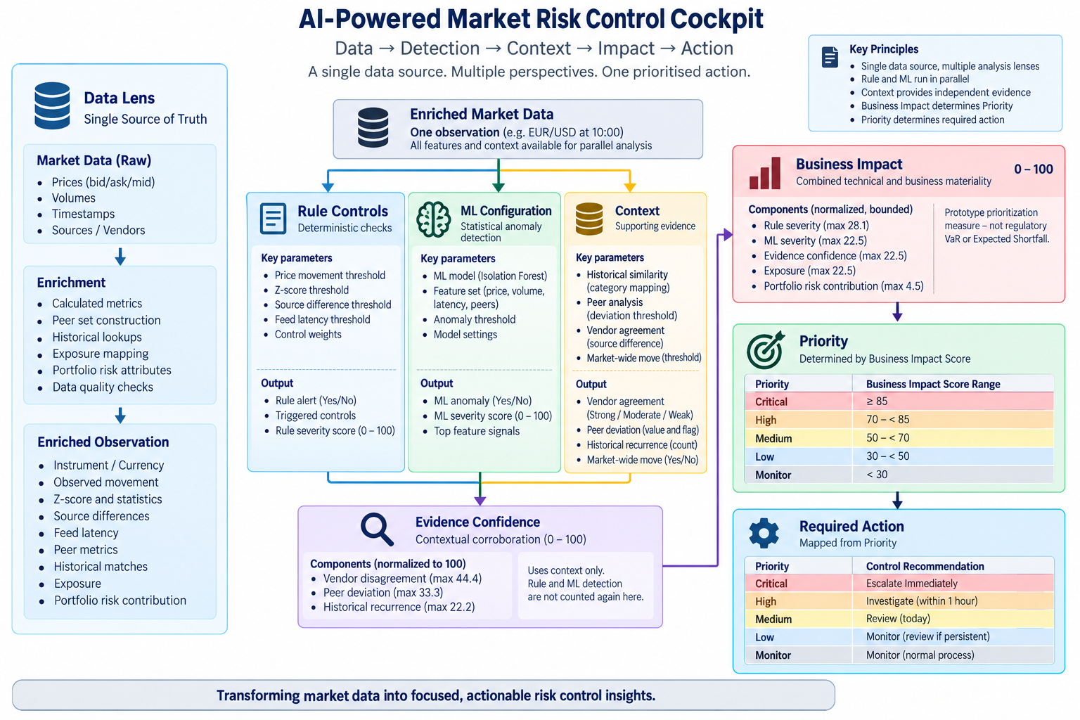

Slide 12
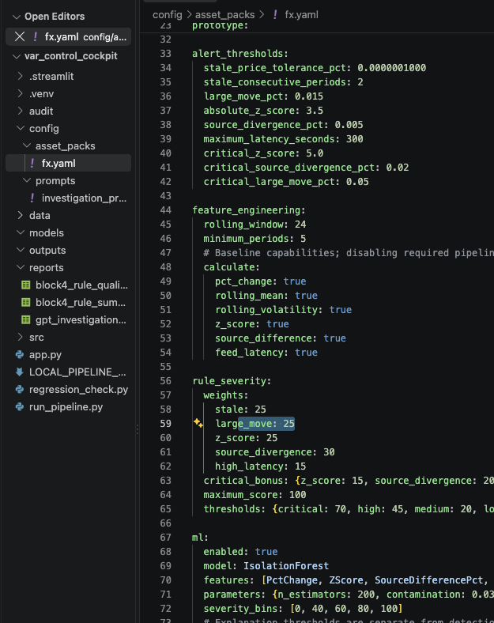
YAML & Manifest based run time controls

Slide 13
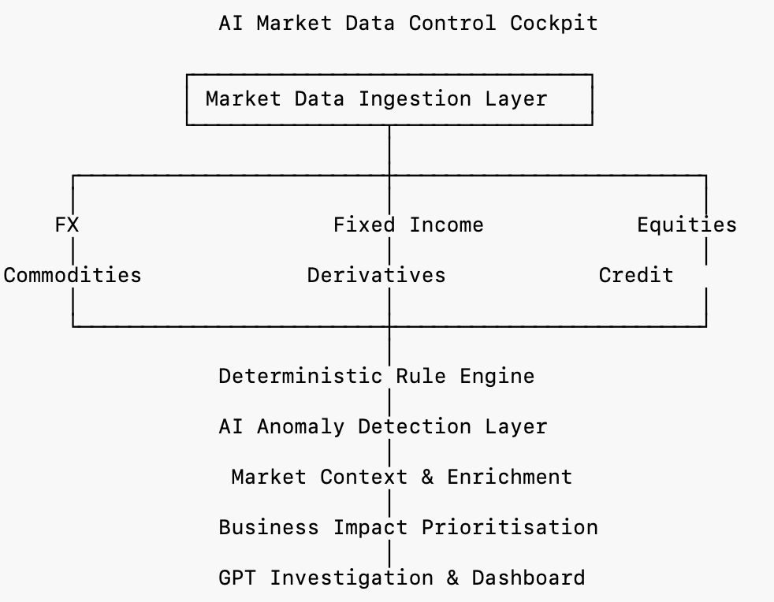
Scalable Archietcture
Today’s demonstration focuses on FX market data because it allowed us to validate the complete end-to-end workflow. However, the platform has been designed as a reusable control framework. By introducing asset-specific deterministic rules and connecting additional market data feeds, the same cockpit can monitor fixed income, equities, commodities, derivatives, credit markets, and even calculated risk metrics such as VaR or Expected Shortfall. This enables a single AI-powered control platform for enterprise-wide market data governance.

Slide 14
Path to Production
Capability | Hackathon Implementation | Proposed Production Implementation
Market Data Source | Synthetic FX market data (Reuters/Bloomberg simulation in CSV) | Live market data from Reuters, Bloomberg, ICE, exchanges, or internal market data platforms via streaming APIs
Data Processing | Python (Pandas) | Databricks, Apache Spark, or Kafka Streams for scalable real-time processing
Rule Engine | Python-based deterministic validation rules | Enterprise Business Rules Engine or centrally managed configurable rule service integrated with market data governance
AI Anomaly Detection | Isolation Forest (Scikit-learn) | Databricks ML, or enterprise MLOps platform with continuous monitoring, retraining, and model governance
Market Context Enrichment | Simulated scenarios and derived context | Live economic calendars, market news, volatility indices, reference data, peer asset movements, and macro event feeds
Business Impact Engine | Python calculations using synthetic exposures, P&L, and VaR | Integration with Market Risk systems using live positions and risk measures
Generative AI Investigation | OpenAI GPT API | Azure OpenAI or approved enterprise LLM with Responsible AI controls, prompt governance, audit logging, and human approval workflow
Dashboard | Stream lit | React/Angular web application with Power BI, Grafana, or internal enterprise dashboard framework
Alert Storage | CSV files | Enterprise database (Azure SQL, PostgreSQL) with full audit trail
Workflow & Case Management | Manual review | Integration with ServiceNow, or enterprise incident management platforms
Authentication & Security | None (prototype) | Enterprise IAM (Azure AD/Entra ID), RBAC, MFA, encryption, and full audit logging
Deployment | Local Terminal | Azure Kubernetes Service (AKS), or bank-approved cloud platform with CI/CD
Monitoring & Observability | Manual execution | COP (Central Observability Platform)

Slide 15
Built in Python and Streamlit, combining deterministic market-risk controls, Isolation Forest ML for anomaly detection, contextual evidence and business-impact prioritization. OpenAI LLMs provide governed investigation narratives and natural-language Risk Copilot capabilities. Configuration is YAML-driven, with pandas-based analytics, explainable scoring, read-only query execution and human-in-the-loop decision making.
The key challenge was moving beyond simply detecting anomalies to determining which alerts genuinely matter to the business. Rule-based controls can generate significant alert volumes, while ML can identify additional unusual patterns; however, technical severity alone does not indicate business priority.
We therefore had to design an explainable framework that combines rule severity, ML anomaly severity, contextual evidence, exposure and portfolio-risk contribution into a business-impact score and actionable priority, while avoiding double counting between these signals.
A second challenge was maintaining trust and governance when using GenAI. We deliberately separated deterministic analytics from LLM capabilities: Python and ML perform calculations and detection, while the LLM is restricted to explaining saved results and supporting natural-language interaction. The Risk Copilot also required safeguards so natural-language questions are converted into validated, read-only queries executed deterministically rather than allowing the LLM direct control over data.
Other challenges included creating meaningful synthetic market and portfolio data, making ML results explainable to non-technical users, ensuring configuration and thresholds were auditable, and designing a UI that provides management-level simplicity while retaining detailed evidence for analysts.
The resulting design follows a core principle: Python calculates, ML detects, LLM explains, and humans decide.
The next step is to evolve the prototype into a controlled enterprise pilot using historical and representative market-risk control data.
Key priorities include validating detection and prioritization with Market Risk and Market Data Operations teams, back-testing against historical investigations, calibrating thresholds and scoring, and measuring improvements in alert prioritization, investigation time, detection quality and analyst acceptance.
The solution can then progressively integrate additional enterprise data sources such as positions and exposures, trades, risk limits and historical control cases, giving Risk Copilot a broader governed view of risk.
Further development will focus on production-grade security, access controls, monitoring, auditability, model governance and integration with existing risk workflows and enterprise AI platforms.
The longer-term vision is a unified AI-powered Risk Control Cockpit that helps analysts move from thousands of technical signals to a small, explainable and business-prioritized investigation queue—while keeping critical calculations and control decisions deterministic and humans accountable for final decisions.

